Slide 1

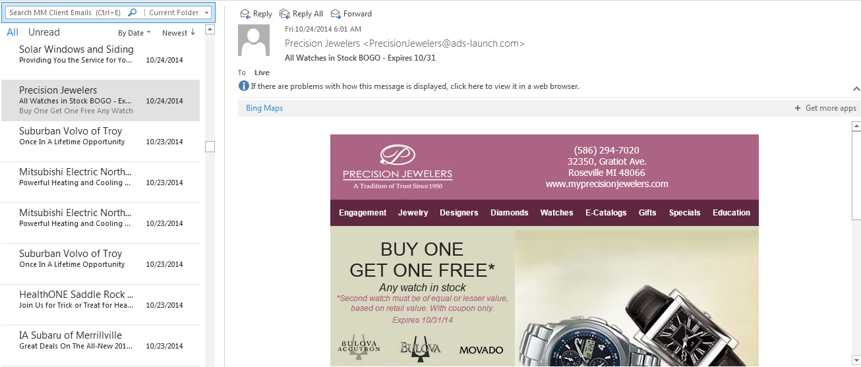

Newsletter Campaigns
NEWSLETTER N.
A periodically sent publication containing current events or the like, generally on a particular topic or geared toward a limited audience. (Wikidictionary)
Notes:
Consumers

Slide 2
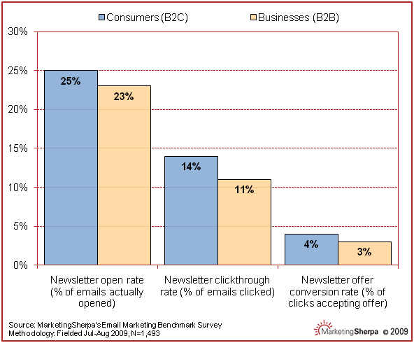
Newsletter Campaigns
WHY SELL NEWSLETTERS?
2X TO 3X THE READERSHIP
10X TO 20X THE CLICKS
PLUS MORE LIKELY TO PRODUCE CONVERSIONS
NEWSLETTERS ROCK RESULTS FOR ADVERTISERS!

Slide 3
Newsletter Campaigns
WHAT DO ADVERTISERS NEED?
LOTS OF IDEAS
ENGAGING WRITING & DESIGN
HELP WITH THEIR EMAIL LIST
THE KNOW-HOW TO SEND IT
FULL SERVICE
NEWSLETTER CAMPAIGNS
WE WRITE
WE DESIGN
WE DEPLOY
SENT TO ADVERTISER’S LIST AND TARGETED PROSPECTS!

Slide 4
Newsletter Campaigns
WHAT’S THE VALUE?
ALL THIS FOR ONE LOW PRICE !
Write and design newsletter
Hyperlink to website or landing page
Hygiene the Advertiser’s list
Add 2x the names (up to 50,000)
Deploy Advertiser’s Newsletter
Retarget Openers and Clickers
Report email and retargeting Results
MONTHLY NEWSLETTER CAMPAIGN
Minimum – 3 months
Send Up to 50,000 messages*
We Write, Design, Deploy, & Retarget Your Responders!
Total: $2500 ($50 per thousand!)
*combination of Advertiser’s list and permission based prospect list

